Slide 1
Unit 4: For Live Session Assignment
Alternatives to the t-tools
Welch t-test

Slide 2
Nonparametric Methods
A nonparametric or distribution-free test doesn’t depend on underlying assumptions
This makes them ideal for use when the assumptions of non-nonparametric (that is, parametric) tests aren’t met
The trade-off is that nonparametric methods perform somewhat worse than parametric methods if the assumptions are approximately correct
The first nonparametric method we will consider is the ”rank sum test”

Slide 3
The Rank Sum Test Description
We can compute the rank sum test statistic using the following steps:
List all observations from both groups in increasing order
Assign each observation a rank, from 1 to n where n is the total # of observations
If there are any ties, assign each tied observation’s rank to be the average of their ranks.
Identify each observation by its group
The test statistic, T, is the sum of the ranks in one of the groups.
We can find a p-value in two ways:
Normal approximation
Re-randomization (exact or approximate)

Slide 4
Rank Sum Test Advantages
No distributional assumptions
Resistant to outliers
Performs nearly as well as the t-test when the two populations are normal and considerably better when there are extreme outliers
Works well with ordinal (as opposed to interval data)
Works with censored values
It still requires some assumptions:
All observations are independent
The Y values are ordinal

Slide 5
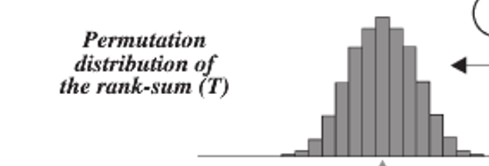
The Sampling Distribution of The Rank Sum Statistic
Rank Sum test statistic (sum of ranks of one group) is approximately normally distributed.

Slide 6
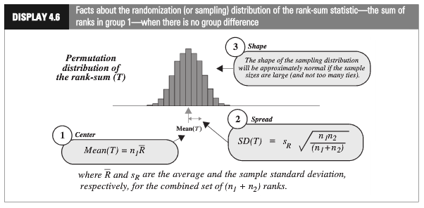
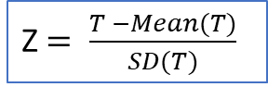
Rank-Sum Test: Normal Approximation
Z $= \frac{T −Mean(T)}{SD(T)}$
Do not get confused.
Not a t distributed statistic!

Slide 7
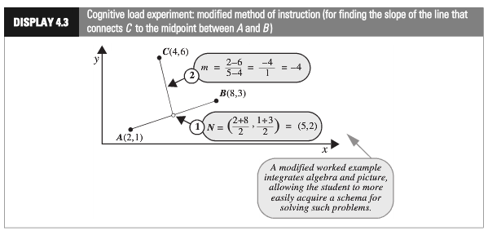
Example: Cognitive Load Experiment
Researchers compared the effectiveness of conventional textbook examples to modified ones
They selected 28 ninth-year students who had no previous exposure to coordinate geometry
The students were randomly assigned to one of two self study instructional groups, using conventional and modified instructional materials
After instruction, they were given a test and the time to complete one of the problems was recorded
Is there sufficient evidence to suggest that the cognitive load theory (modified instruction) shortened response times?
This is the problem the students were given.

Slide 8
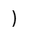
Rank-Sum Test Using Cognitive Data and Normal Approximation

Slide 9
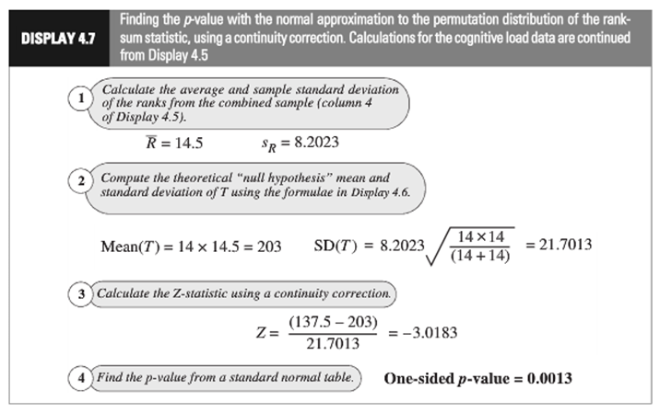
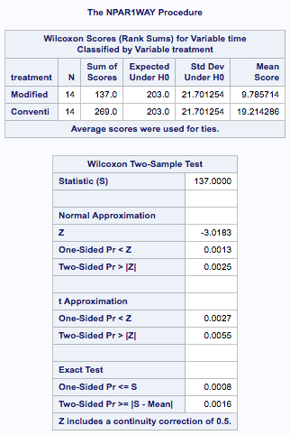
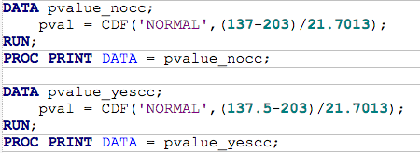
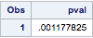
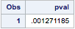
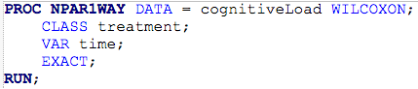
Cognitive Load Experiment: Using SAS
Continuity correction

Slide 10
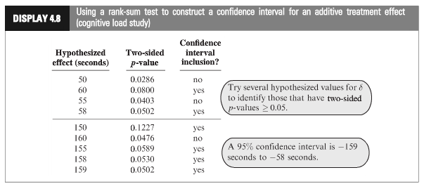
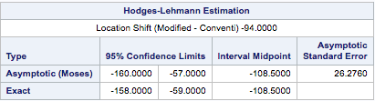
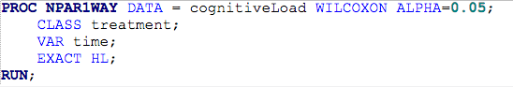
Cognitive Load Experiment Confidence Interval for Group Difference
In R: wilcox.test(Score~Method, exact = TRUE, alternative = "two.sided", conf.int = TRUE)
Statistical Conclusion : A range of plausible values for how much smaller the “modified” distribution is than the “traditional” (treatment effect) is [-158, -59] (95% conﬁdence interval based on a rank-sum test) with a point-estimate of -108.5.

Slide 11

Cognitive Load Experiment: Hypothesis Test Conclusion
H₀: Distribution of Modified and Conventional Scores are
equal
H_{a}: Distribution of Modified Scores is less than that of
Conventional
Critical Value (left sided): -1.645 (alpha = .05)
Test Statistic: z-stat = -3.0183
P-value (left sided)= .0013
Reject H₀
Normal Approximation
Statistical Conclusion (continued): The data provide convincing evidence that a student could solve the problem more quickly after the “modiﬁed” rather than the “conventional” method (one-sided, normal approximation w/ C.C. p-value = 0.0013, from the rank-sum test). A range of plausible values for how much smaller the “modified” distribution is than the “traditional” (treatment effect) is [-158, -59] sec. (95% conﬁdence interval based on a rank-sum test) with a point-estimate of -108.5 sec.

Slide 12
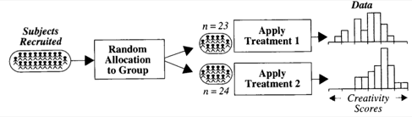
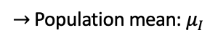
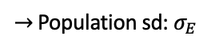
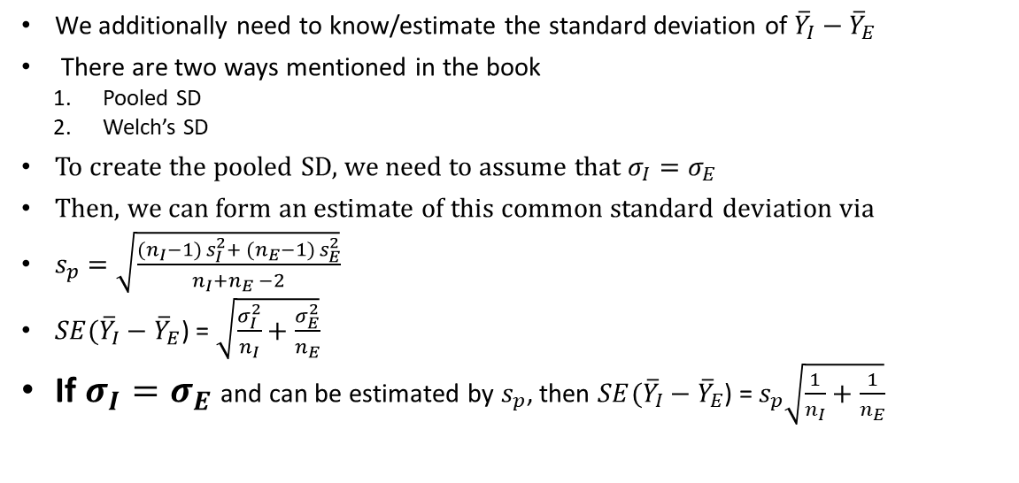
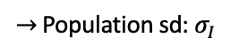
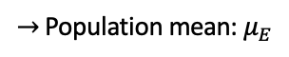
Creativity Study: Reminder
$→$ Population mean: $μ_{I}$
I
$→$ Population sd: $σ_{I}$
$→$ Population mean: $μ_{E}$
E
$→$ Population sd: $σ_{E}$
We additionally need to know/estimate the standard deviation of ${\overline{Y}}_{I}−{\overline{Y}}_{E}$
There are two ways mentioned in the book
Pooled SD
Welch’s SD
To create the pooled SD, we need to assume that $σ_{I}=σ_{E}$
Then, we can form an estimate of this common standard deviation via
$s_{p}=\sqrt{\frac{({n_{I}−1) s}_{I}^{2}+ ({n_{E}−1) s}_{E}^{2}}{n_{I}+n_{E} −2}}$
$SE({\overline{Y}}_{I}−{\overline{Y}}_{E}$) = $\sqrt{\frac{σ_{I}^{2}}{n_{I}}+\frac{σ_{E}^{2}}{n_{E}}}$
If $σ_{I}=σ_{E}$ and can be estimated by $s_{p}$, then $SE({\overline{Y}}_{I}−{\overline{Y}}_{E}$) = $s_{p}\sqrt{\frac{1}{n_{I}}+\frac{1}{n_{E}}}$
What if Equal Variances assumption isn’t true?
What if Normal assumption isn’t true?

Slide 13

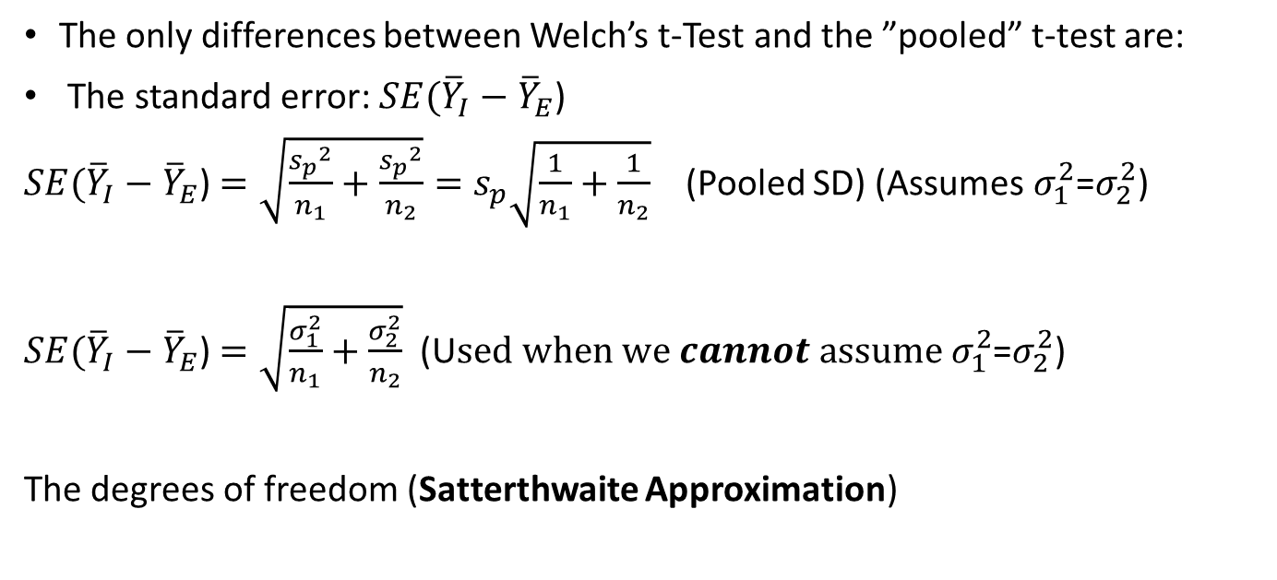
Welch’s t-Test – Use when cannot assume equal variances
The only differences between Welch’s t-Test and the ”pooled” t-test are:
The standard error: $SE({\overline{Y}}_{I}−{\overline{Y}}_{E}$)
$SE({\overline{Y}}_{I}−{\overline{Y}}_{E}$) $=\sqrt{\frac{{s_{p}}^{2}}{n_{1}}+\frac{{s_{p}}^{2}}{n_{2}}}=s_{p}\sqrt{\frac{1}{n_{1}}+\frac{1}{n_{2}}}$ (Pooled SD) (Assumes $σ_{1}^{2}$=$σ_{2}^{2}$)
$SE({\overline{Y}}_{I}−{\overline{Y}}_{E}$) $=\sqrt{\frac{σ_{1}^{2}}{n_{1}}+\frac{σ_{2}^{2}}{n_{2}}}$ (U$sed when we cannot assume σ_{1}^{2}$=$σ_{2}^{2}$)
The degrees of freedom (Satterthwaite Approximation)

Slide 14
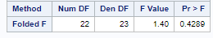
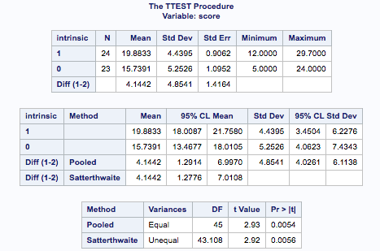
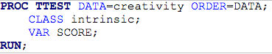
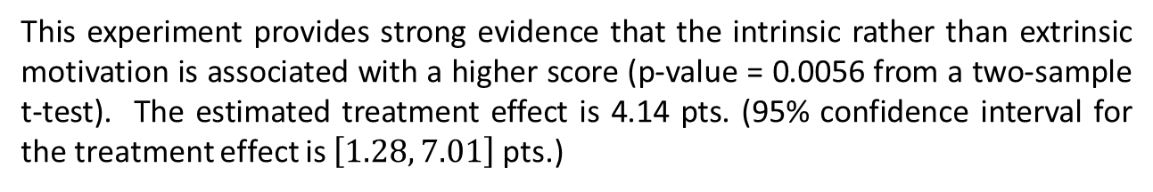
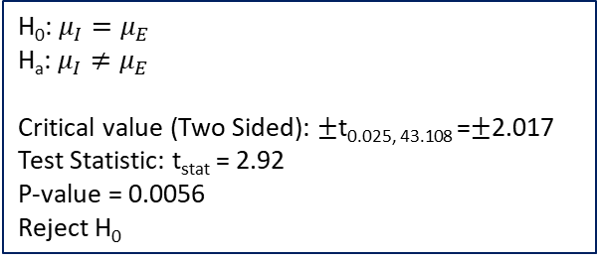
Testing Hypothesis: Welch’s t-Tools Applied to Creativity Data
No equality of variances
In R: t.test(Score~Treatment_S, data = Creativity, var.equal=FALSE)
H₀: $μ_{I}=μ_{E}$
H_{a}: $μ_{I}≠μ_{E}$
Critical value (Two Sided): $±$t_{0.025, 43.108} =$±$2.017
Test Statistic: t_{stat} = 2.92
P-value = 0.0056
Reject H₀
This experiment provides strong evidence that the intrinsic rather than extrinsic motivation is associated with a higher score (p-value = 0.0056 from a two-sample t-test). The estimated treatment effect is 4.14 pts. (95% confidence interval for the treatment effect is $\left[1.28, 7.01\right]$ pts.)

Slide 15
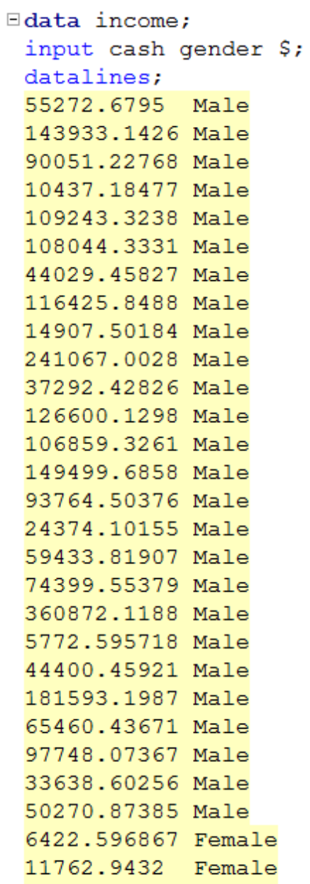
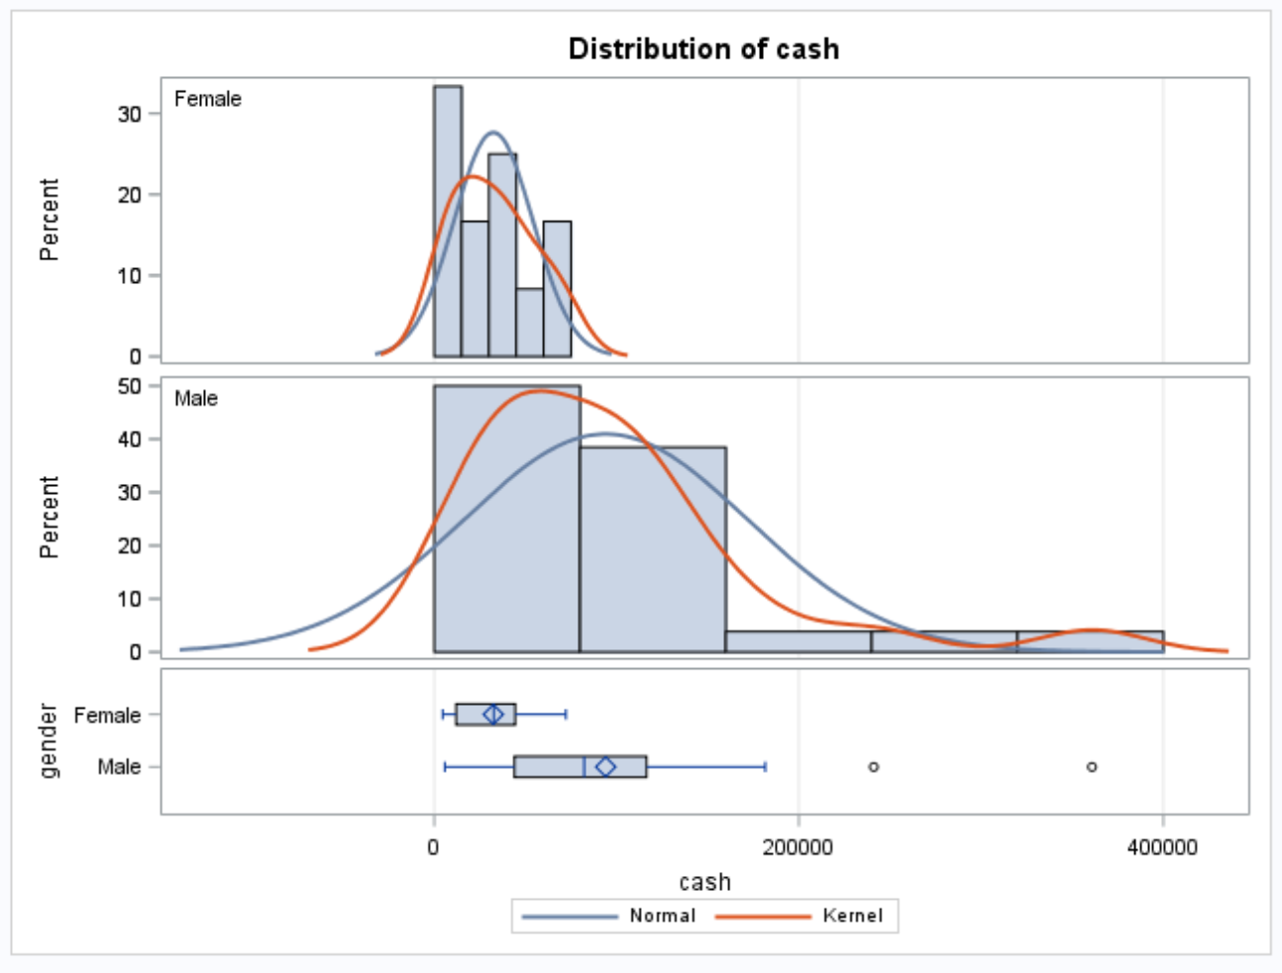
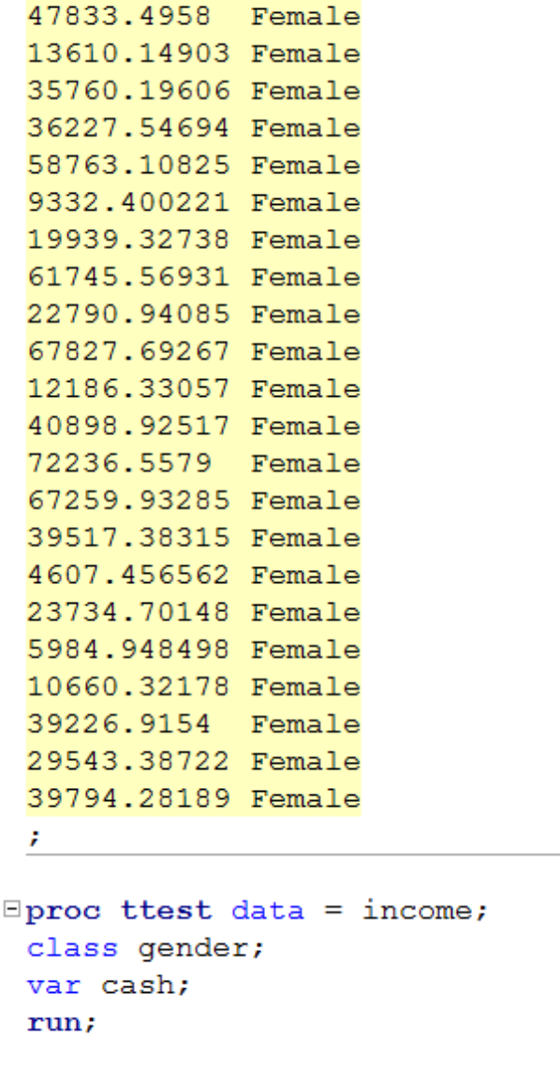
Gender Income Discrimination - Data

Slide 16
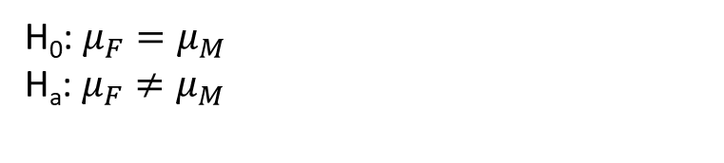
Gender Income Discrimination Hypotheses and Assumptions
H₀: $μ_{F}=μ_{M}$
H_{a}: $μ_{F}≠μ_{M}$
Strong evidence against normality, but CTL applies.
Strong evidence against equal standard deviations and different sample sizes.
They are close but the standard deviations appear to be so different that this may make a real difference.
We will assume independence.
Student’s t-test may not be a good idea here. But, we have fairly large sample so we will use it with the Welch Test.

Slide 17
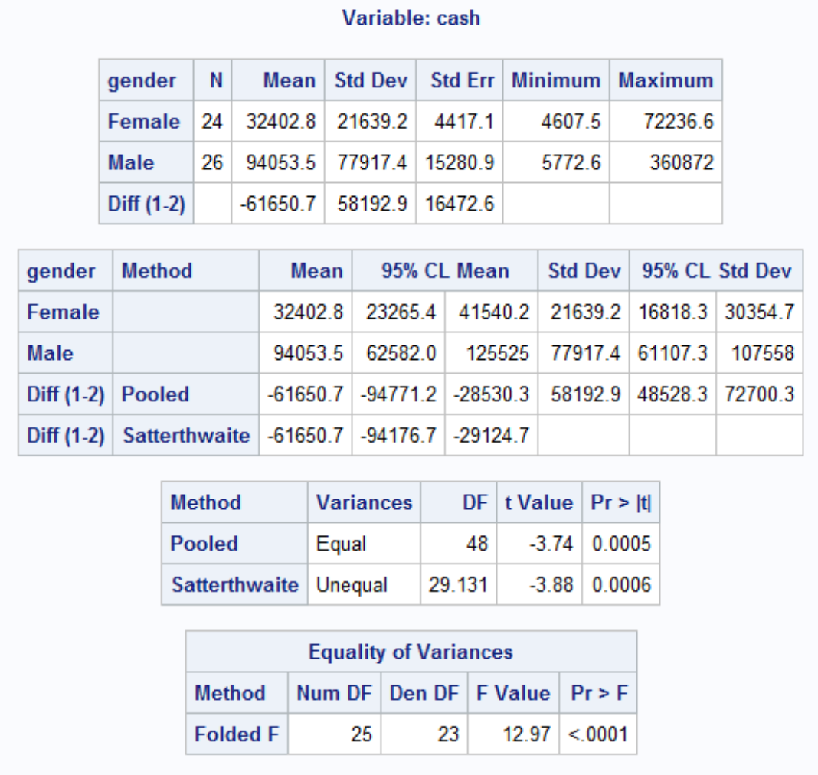
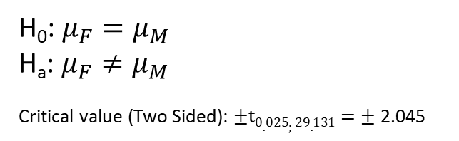
Gender Income Discrimination Conclusion
H₀: $μ_{F}=μ_{M}$
H_{a}: $μ_{F}≠μ_{M}$
Critical value (Two Sided): $±t0.025;29.131=±$2.045
Test Statistic: t_{stat} = -3.88
P-value = .0006
Reject H₀
Conclusion: There is strong evidence to suggest that the mean income of the female group is different from the mean income of the male group (p-value = 0.0006). A 95% confidence interval for this difference is ($29,124, $94,176) in favor of the males.
That is quite a difference!

Slide 18
R – Code for Class Examples is in the Session 4 Folder. Note: R Reports W for the Rank-Sum Test and will not compute an exact test if there are rank ties in the data.

Slide 19
Log Transformations
Can help deal with deviations from Normality.
Can help with Unequal standard deviations.
Hypothesis for log transformed data is testing ratios of medians rather than means, see pp. 72-73 of the text.
If confidence intervals contains 1 with log transformed data, the null hypothesis of equal medians is not rejected.

Slide 20
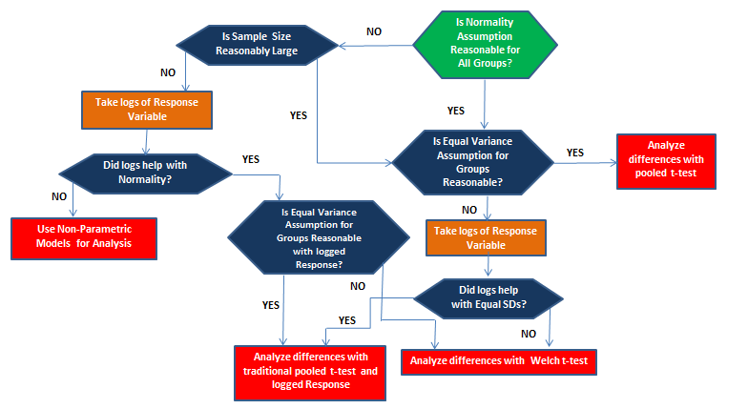
Flowchart for Testing Means or Medians Between Two Groups

Slide 21
Techniques and Tests to Evaluate Normality and Constant Variance Assumptions for Response Variance

Slide 22
Live Session Questions

Slide 23
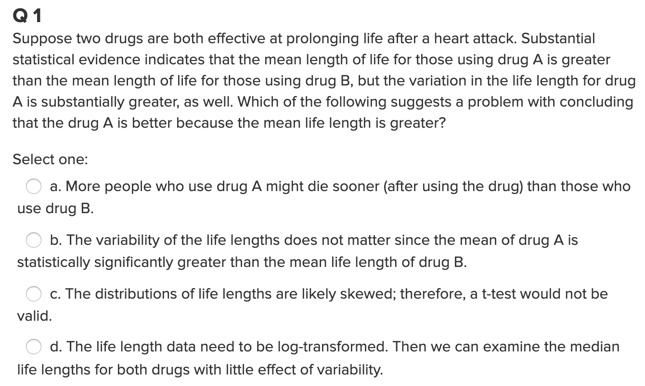
Quick Quiz Question 1

Slide 24
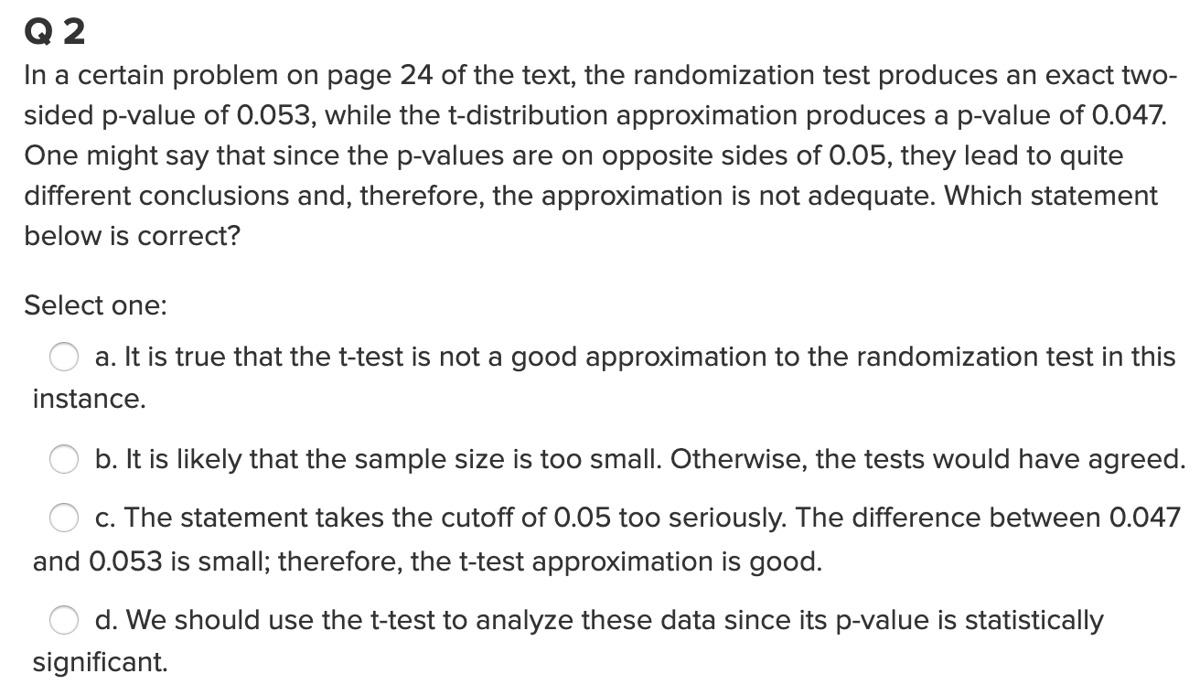
Quick Quiz Question 2

Slide 25
Question 1 (2 hours)
IBM gives each employee in the marketing department technical training
Based on further testing, it appears the traditional training method isn’t effective
Hence, a new training method is developed
Below are the test scores of 4 individuals who just finished the “New Method” and the last 3 test scores from employees trained via the “Traditional Method” course
Is there evidence to suggest that the “New Method” increases test scores?
Address the assumption of a t-test to answer this question.
Perform the test you feel is appropriate given the methods you have learned thus far.
As a reminder: Please clearly address this problem with slides that you will present in breakout and submit those slides to 2DS before live session (preferably 24 hours before.)
New Method | Traditional Method
37 | 23
49 | 31
55 | 46
77

Slide 26
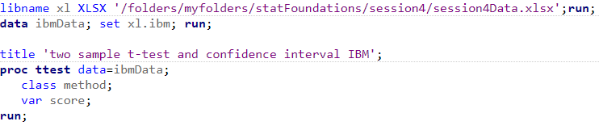
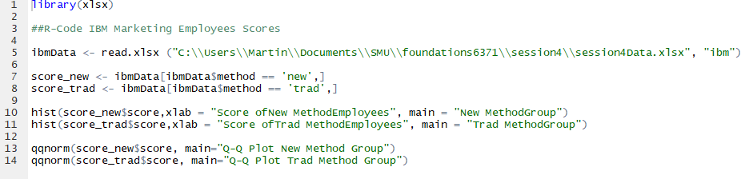
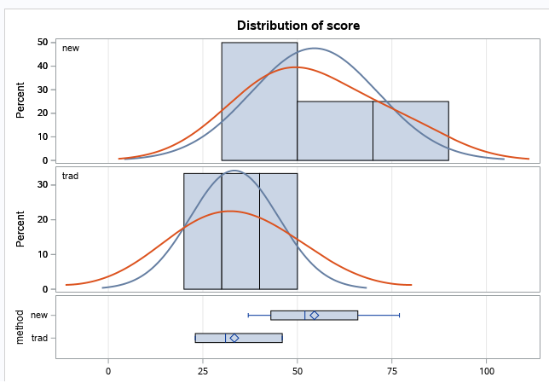
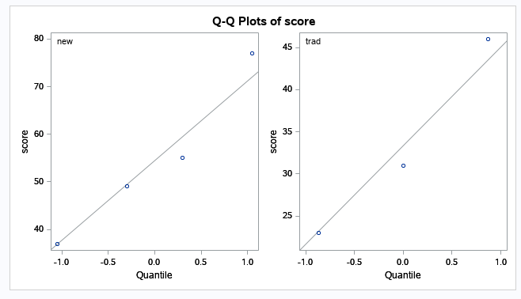
Question 1: Examining the t-Tools Assumptions
Since the standard deviations appear (visual check) to be different and the sample sizes are both different and exceptionally small, the t-test was not deemed appropriate and the nonparametric rank sum test is performed.

Slide 27
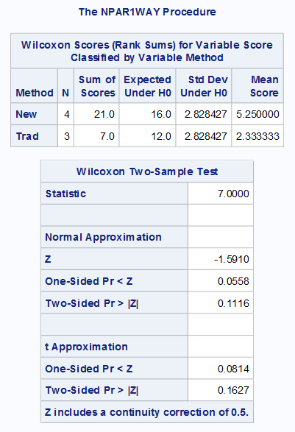
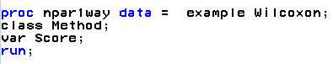
Question 1: Rank-Sum Test: Normal Approximation Applied to IBM Data
Common interpretation:
H₀: The distribution of New Method Scores = The distribution of the Traditional Method Scores
H₁:The distribution of New Method Scores > The distribution of the Traditional Method Scores
Technical mathematical interpretation:
H₀: Average rank of New Method Scores = Average rank of all Scores (constant)
H₁: Average rank of New Method Scores > Average rank of all Scores (constant)
R Code
wilcox.test(ibmData$score~ibmData$method, exact=FALSE, alternative = "greater")
SAS Code
There is mild evidence (alpha = 0.1) to suggest that the distribution (median) of scores from the “New” method is greater than the distribution (median) of the “Traditional” method (normal approximation to rank-sum test p-value = 0.0558).

Slide 28
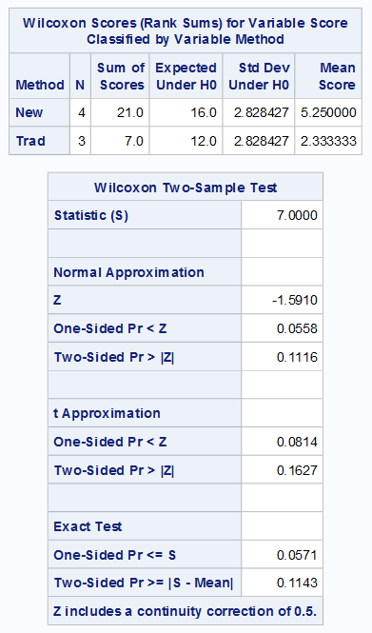
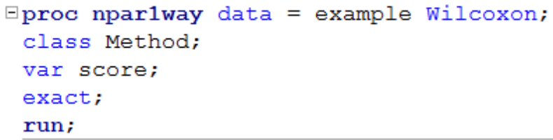
Question 1: Permutation (Exact) Test With Ranked Sums Test Applied to IBM Data (Exact P-value)
Rank the entire dataset regardless of group
Choose one group
Sum the ranks for the chosen group from the sample
Calculate mean rank of the chosen group from the sample
Randomly assign observations to the chosen group and calculate the sum of the ranks and the mean rank for each assignment (permutation)
One-sided Pr <= S: The number of permutations where the sum or ranks is less than that of the sample / number of permutations
Two-sided Pr >= |S-M| : The number of random assignments where the absolute value of the sum or ranks – mean rank is less than that of the sample / number of permutations
R Code
wilcox.test(Score~Method, exact = TRUE, alternative = "greater")
wilcox.test(Score~Method, exact = TRUE, alternative = "two.sided")
SAS Code

Slide 29
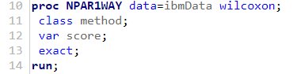
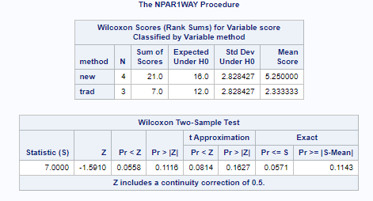
Question 1 Answer: Statistical Conclusion
H₀: Distribution of Employees in New and Traditional Training Groups are equal
H_{a}: Distribution of Employees in New and Traditional Training Groups are not equal
Exact Test shows Pr <= S = 0.0571 which is very close to 0.05, so reject H₀
Statistical Conclusion: The data provides evidence that an employee in the new training group on average scores better than an employee in the traditional training group. The exact Test shows Pr <= S = 0.0571 which is very close to 0.05, so reject H₀

Slide 30
Question 2 (2 hours)
Conduct a Welch’s two-sample t-test on the Education Data from HW 3 (untransformed). Perform a complete analysis using SAS to test the claim that the mean income of college educated people (16 years of education) is greater than the mean of those with a high school education only (12 years of education).
State the problem, address the assumptions. Be sure to support with your knowledge of theory (CLT) as well as with histograms, box plots, q-q plots, etc.
Show all 6 steps, including a thoughtful, thorough, yet non-technical conclusion. Include a confidence interval.
Include a scope of inference at the end. (You may copy and paste this from a previous HW if you like.)
Verify the Welch’s t statistic and p-value with R (using R function t.test). Simply cut and paste your R code and output. You may use: http://rcompanion.org/rcompanion/d_02.html for reference.
Would you prefer to run the log transformed analysis you ran in HW3, or do you feel this analysis is more appropriate? Why or Why not? (Make mention of the assumptions as well as the parameters that each test provides inference on. As you know, they are different.)

Slide 31
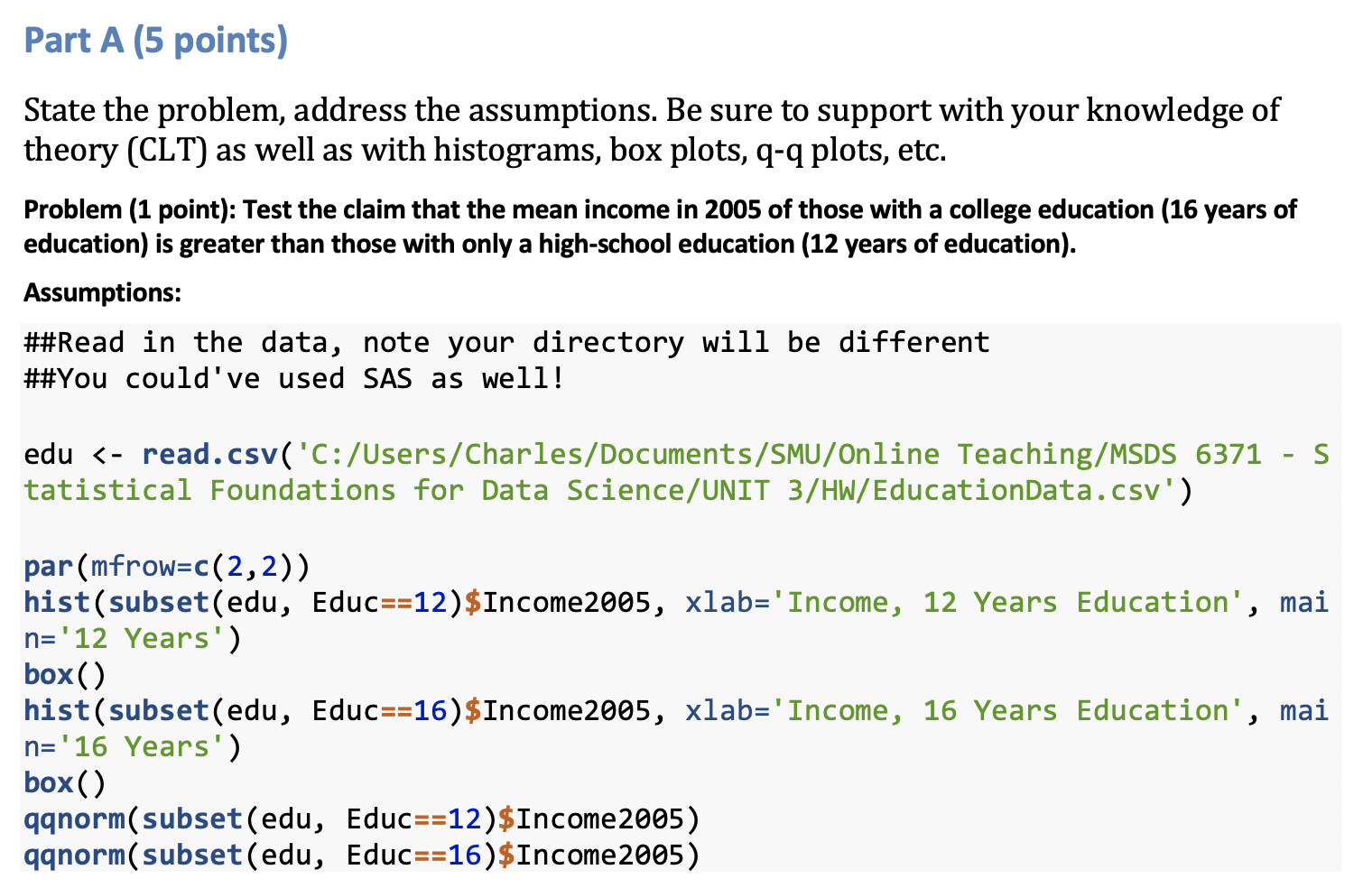
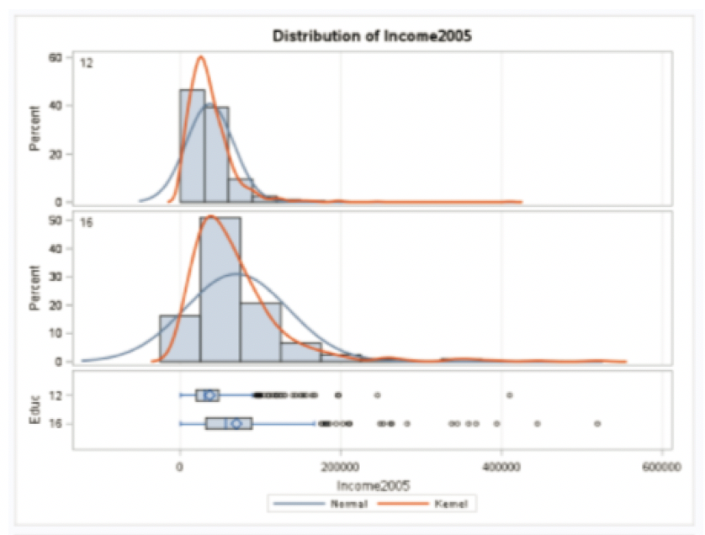
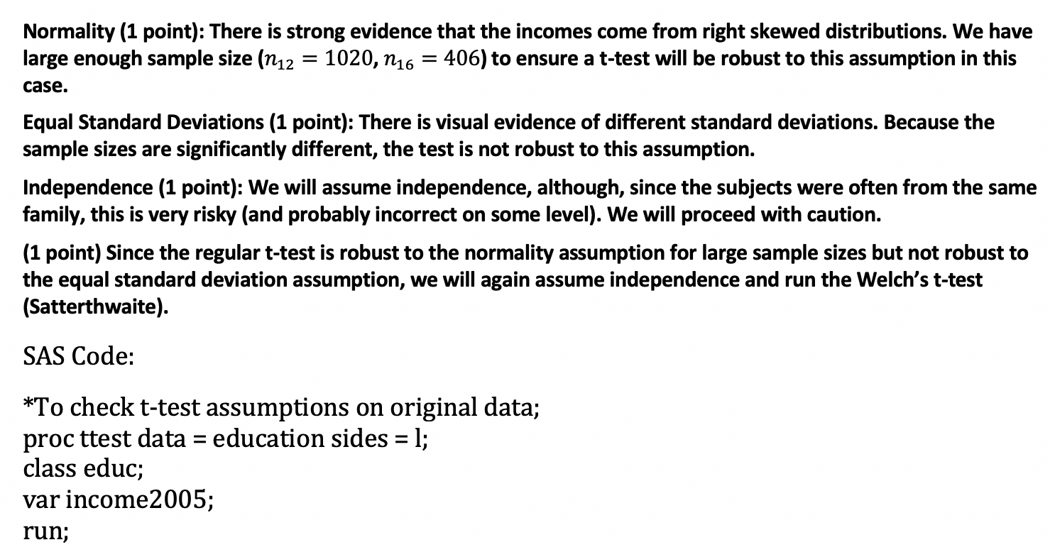
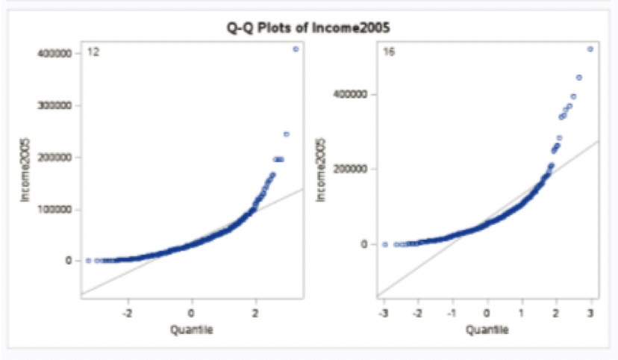
Question 2 - Assumptions

Slide 32
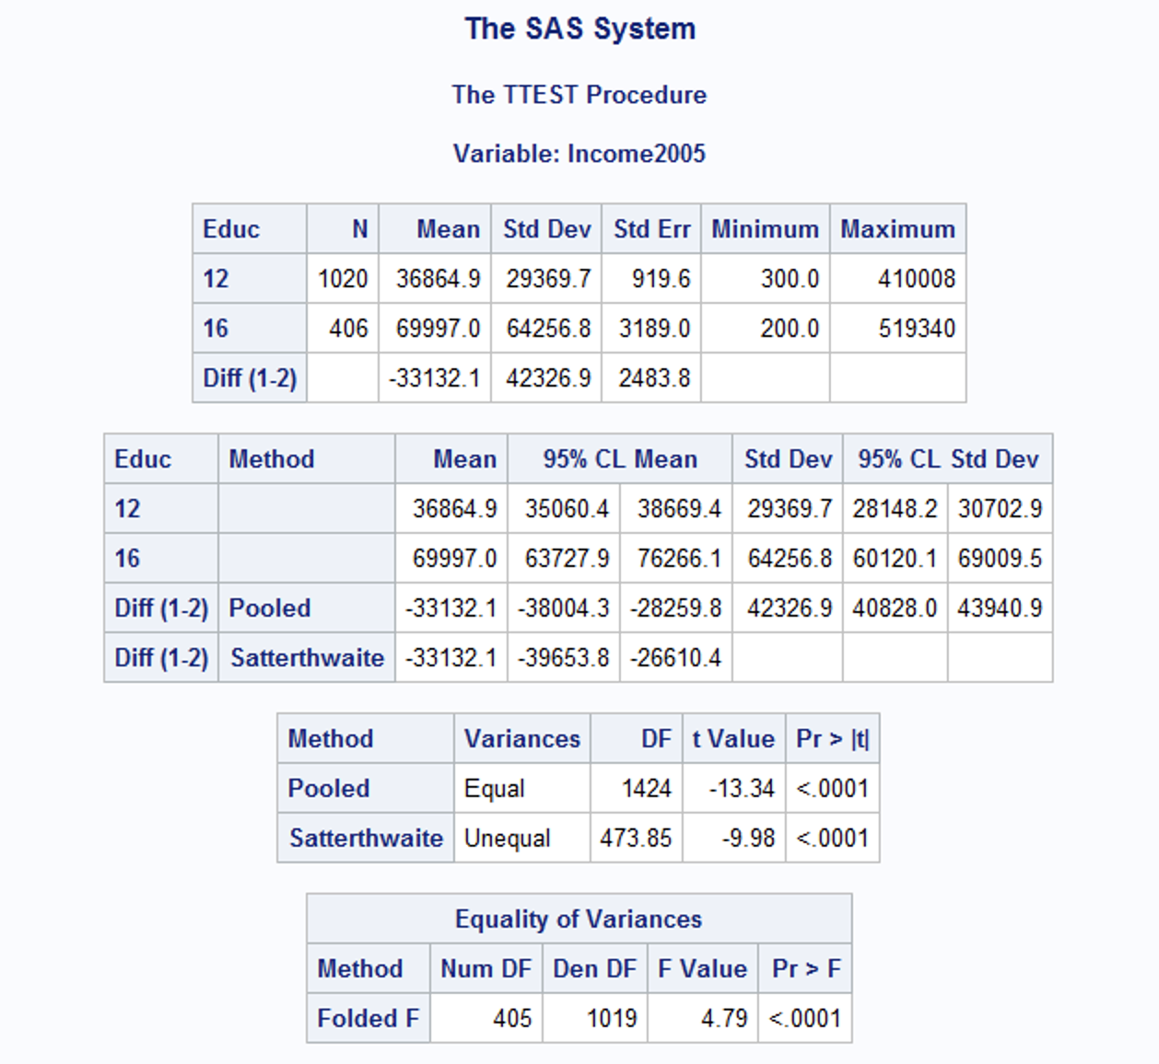


Question 2: Hypotheses, 6 Step Analysis, and Statistical Results
Step 1 - Hypotheses (1 point)
$$H_{o}:μ_{12years}=μ_{16years} \\ H_{a}:μ_{12years}≠μ_{16years}$$
Step 2 - Identification of Critical Value (1 point): $±1.96$
Step 3 - Value of Test Statistic (1 points): $t=−9.98$
Step 4 - Give p-value (1 points): $p<0.0001$
Step 5 - Decision (0 points): Reject $H_{o}$
Step 6 - Conclusion (1 point): There is overwhelming evidence at the $α=0.05$ level of significance ($p<0.0001$) that the mean income in 2005 for people with 16 years of education is larger than the incomes for those in the study that had only 12 years of education. A 95% confidence interval for this increase is $(\$26,610.40, \$39,653.80)$.
SAS code:
proc ttest data = education;
class educ;
var income2005;
run;

Slide 33

Question 2: Scope of Inference

Slide 34


Question 2: R-code

Slide 35

Question 2: Log transform?

